Slide 1




Pizza Sale Dashboard Project
View in Power BI
Last data refresh:
07/12/2024 11:47:52 UTC
Downloaded at:
07/12/2024 11:50:03 UTC

Slide 2
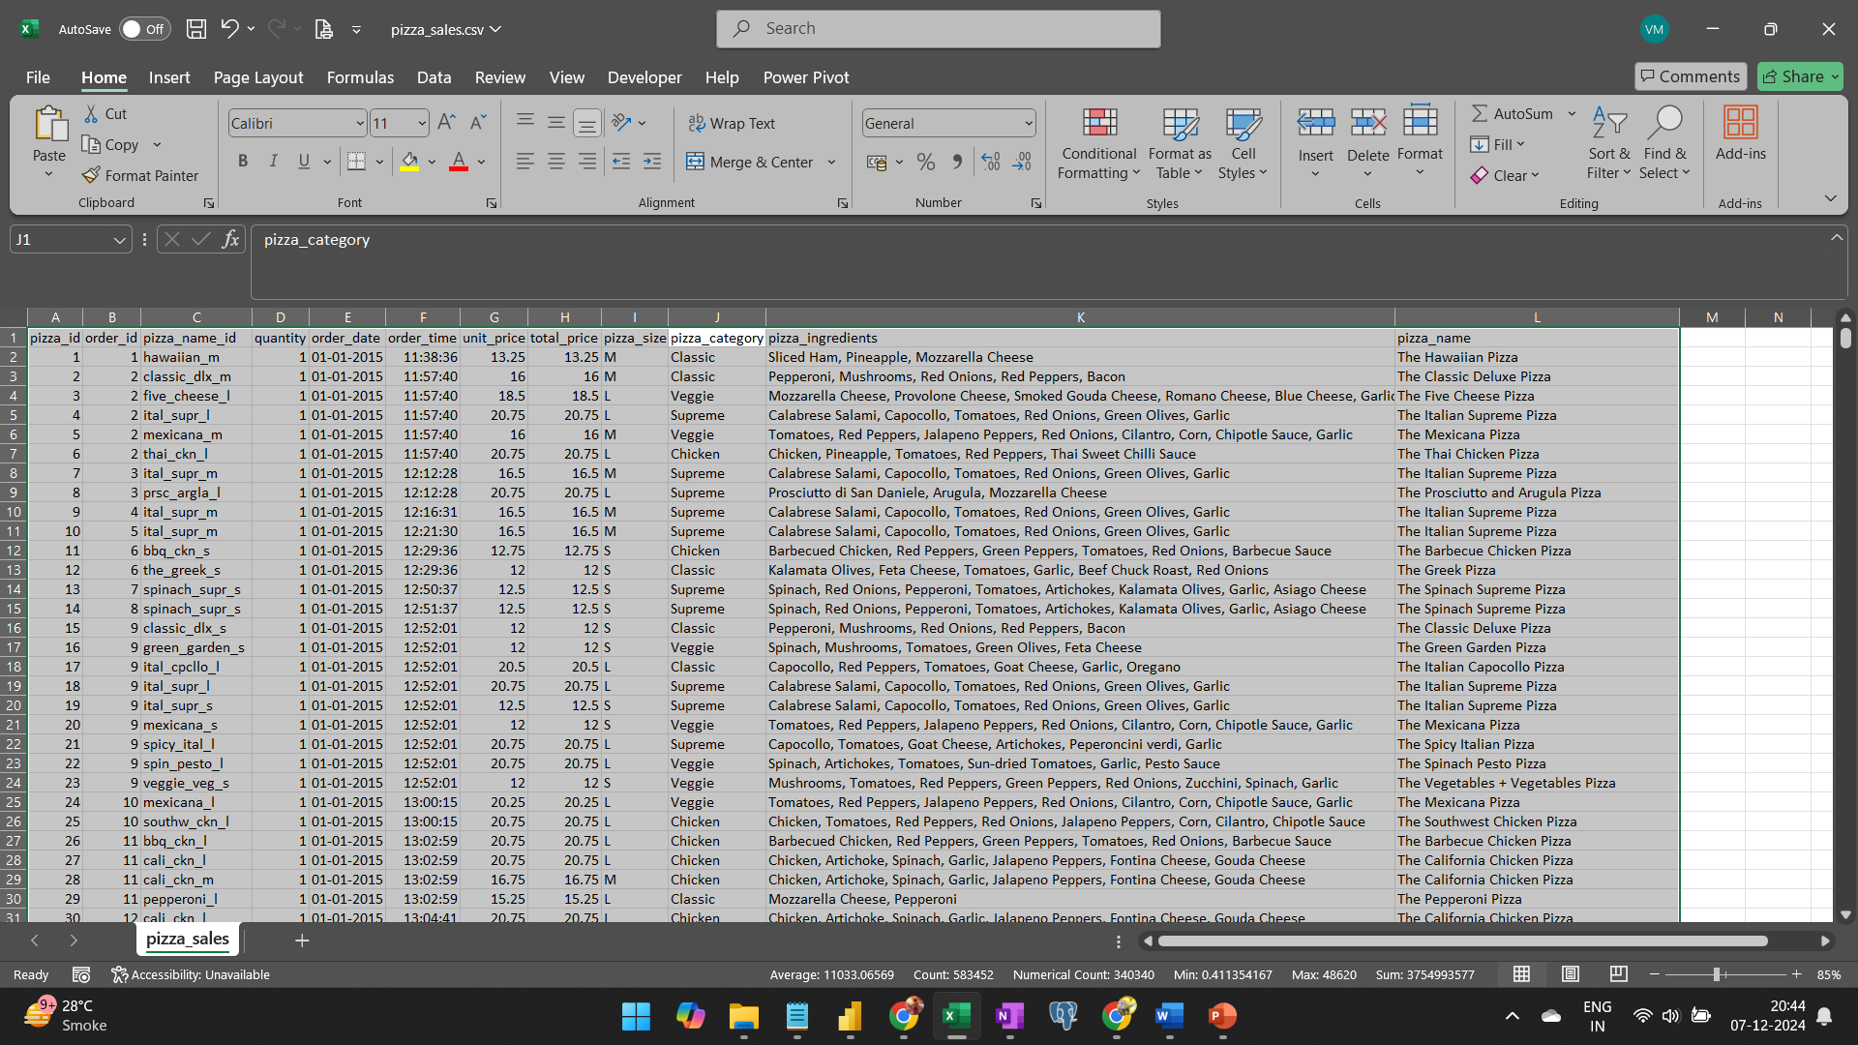
Step1 : Excel Data
Excel CSV file with 48,621 rows of transactional data
Filtered this a bit & exported it to PostgreSQL

Slide 3
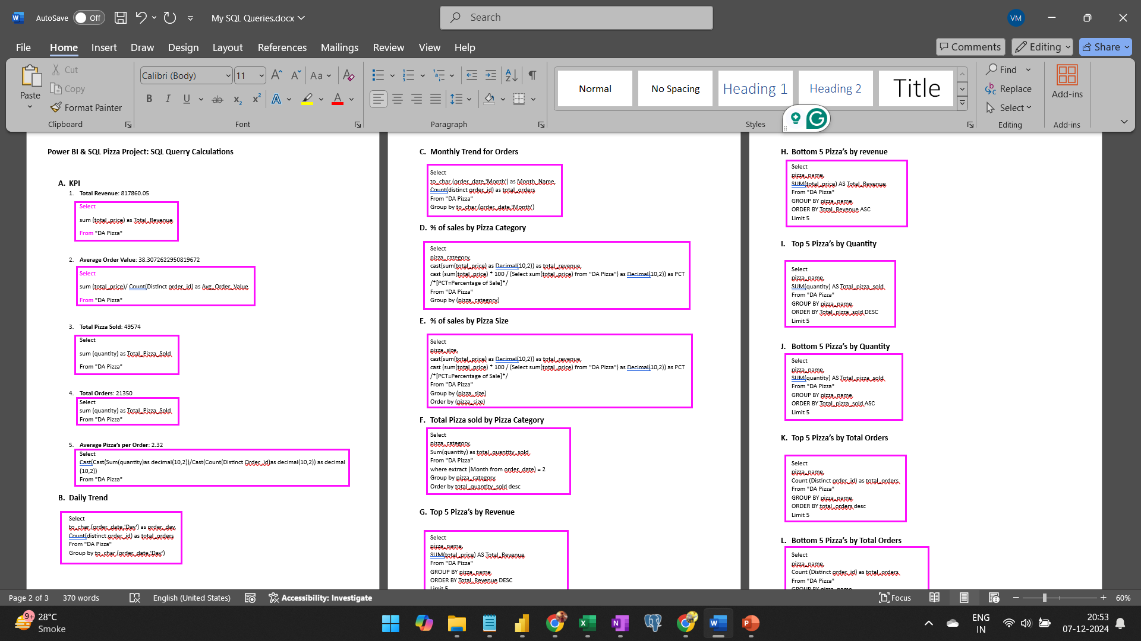
SQL Queries copied on Word File
Imported data in PostgreSQL
Analyzed & Derived the required data with the help of SQL queries.
Imported this data in Power BI and created the Pizza Sale Dashboard

Slide 4
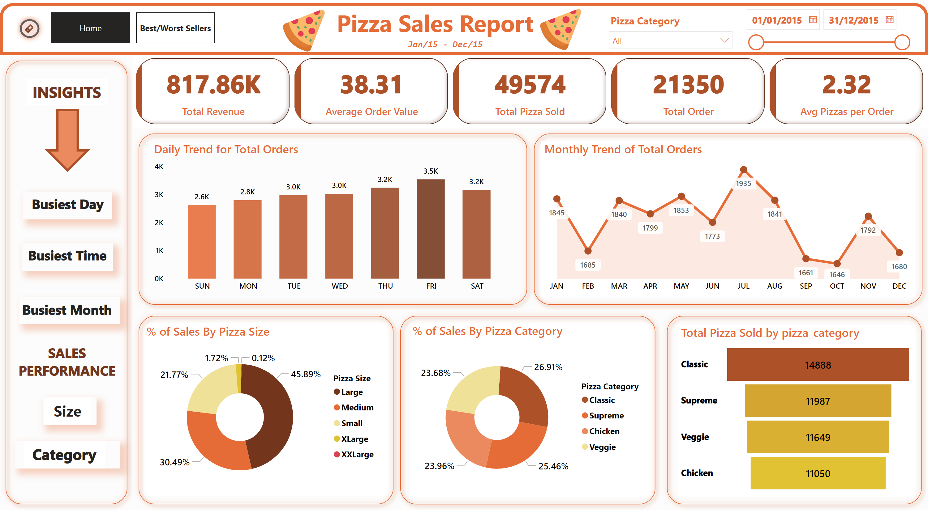
Home
Notes:
cardVisual
No alt text provided
shape
No alt text provided
textbox
No alt text provided
textbox
No alt text provided
image
No alt text provided
image
No alt text provided
shape
No alt text provided
Daily Trend for Total Orders
No alt text provided
Monthly Trend of Total Orders
No alt text provided
shape
No alt text provided
% of Sales By Pizza Category
No alt text provided
% of Sales By Pizza Size
No alt text provided
funnel
No alt text provided
shape
No alt text provided
shape
No alt text provided
shape
No alt text provided
shape
No alt text provided
textbox
No alt text provided
textbox
No alt text provided
textbox
No alt text provided
shape
No alt text provided
shape
No alt text provided
shape
No alt text provided
shape
No alt text provided
textbox
No alt text provided
textbox
No alt text provided
shape
No alt text provided
shape
No alt text provided
textbox
No alt text provided
textbox
No alt text provided
actionButton
No alt text provided
slicer
No alt text provided
slicer
No alt text provided
pageNavigator
No alt text provided

Slide 5
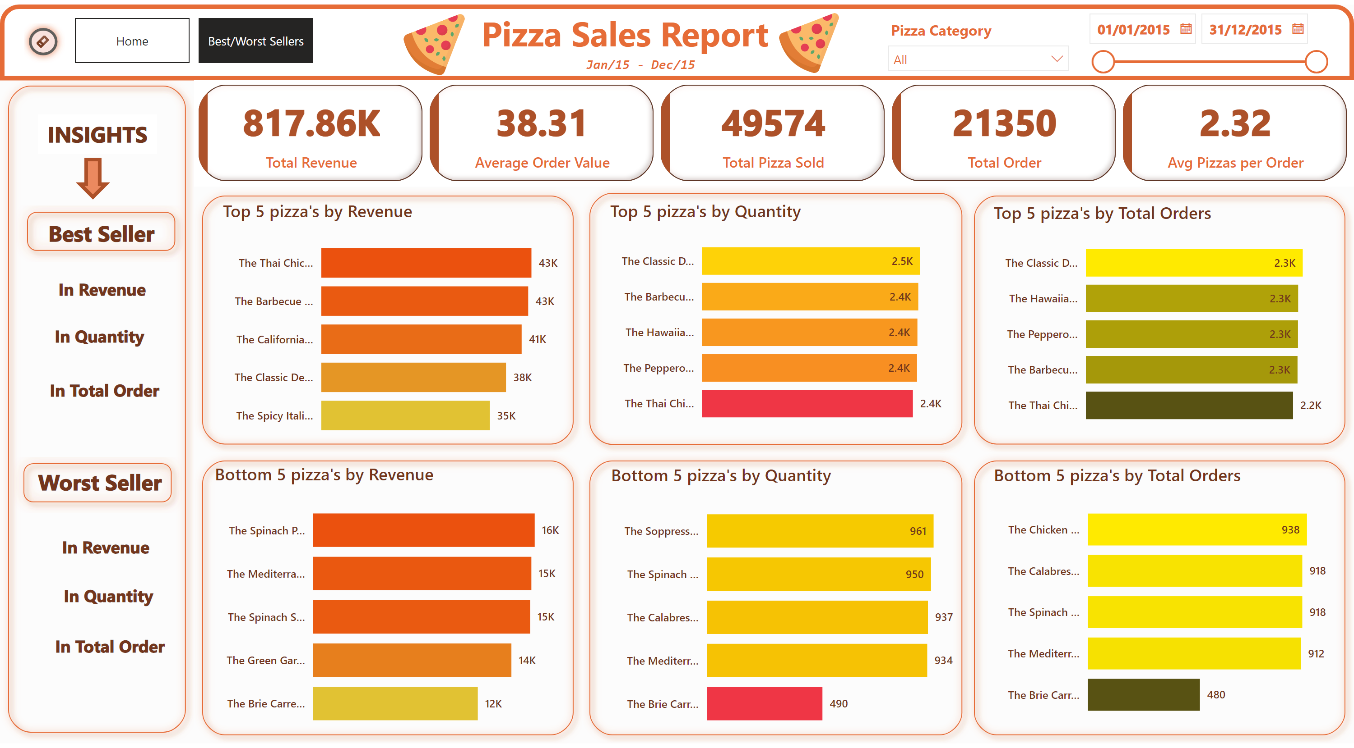
Best/Worst Sellers
Notes:
cardVisual
No alt text provided
shape
No alt text provided
textbox
No alt text provided
textbox
No alt text provided
image
No alt text provided
image
No alt text provided
shape
No alt text provided
shape
No alt text provided
shape
No alt text provided
textbox
No alt text provided
shape
No alt text provided
actionButton
No alt text provided
slicer
No alt text provided
slicer
No alt text provided
shape
No alt text provided
shape
No alt text provided
shape
No alt text provided
Top 5 pizza's by Revenue
No alt text provided
Bottom 5 pizza's by Revenue
No alt text provided
Top 5 pizza's by Quantity
No alt text provided
Bottom 5 pizza's by Quantity
No alt text provided
Top 5 pizza's by Total Orders
No alt text provided
Bottom 5 pizza's by Total Orders
No alt text provided
textbox
No alt text provided
textbox
No alt text provided
textbox
No alt text provided
textbox
No alt text provided
textbox
No alt text provided
textbox
No alt text provided
textbox
No alt text provided
textbox
No alt text provided
shape
No alt text provided
shape
No alt text provided
shape
No alt text provided
shape
No alt text provided
shape
No alt text provided
shape
No alt text provided
shape
No alt text provided
shape
No alt text provided
shape
No alt text provided
shape
No alt text provided
pageNavigator
No alt text provided

